Slide 1
Open Printing Project Updates - 2020
Joint PWG/Open Printing Meeting
May 5, 2020
Aveek Basu - Program Manager
Till Kamppeter - Technical Lead

Slide 2
GSoC 2019 Projects
Generic Framework to turn legacy drivers consisting of CUPS filters and PPDs into Printer Applications: Printer Applications are simple daemons which emulate a driverless IPP network printer on localhost, do the conversion of the print jobs into the printer's format, and send the job off to the printer. And as a physical driverless IPP printer they advertise themselves via DNS-SD and provide there capability information on (IPP) request from the client.
IPP: ipptool test suite for IPP System Service: To develop additional ipptool test scripts for all new operations, objects, attributes defined in IPP System Service v1.0 (e.g., Create-Printer).
IPP: ipptool test suite updates for IPP errata updates: To develop additional ipptool test scripts for IPP errata including IPP Document Object v1.1, IPP Job Extensions v1.1, and IPP 3D Printing Extensions v1.1.
Improve the pdftoraster filter to not need copying Poppler source code or using unstable APIs: One of the filters, pdftoraster, rasterizes PDF files into CUPS/PWG Raster, uses Poppler but makes use of unstable APIs of Poppler, requiring frequent modifications when Poppler gets updated. The task for the student is here to improve pdftoraster's interface with Poppler, for example using Poppler's PPM (generic raster) output and converting it into CUPS/PWG Raster.
Turn the scp-dbus-service of system-config-printer into: System-config-printer was written in Python and therefore scp-dbus-service is also written in Python. This makes it depend on Python and the related libraries to get loaded into memory when started. This can cause delays during boot. The student's task is to turn the scp-dbus-service of system-config-printer into C, either as D-Bus service (would work out-of-the-box with many GUIs) or as a C library with API (simpler), ideally both. This will make it easier to write printer setup tools in practically any programming language.

Slide 3
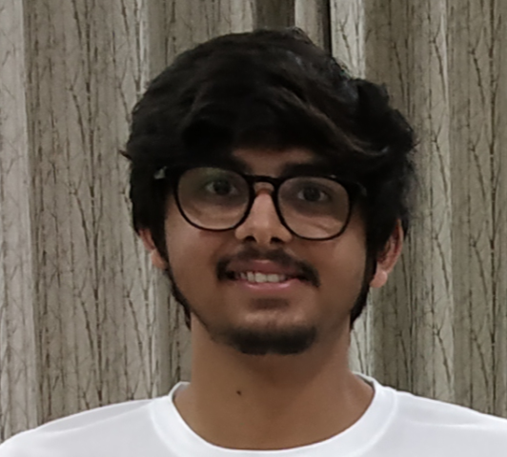
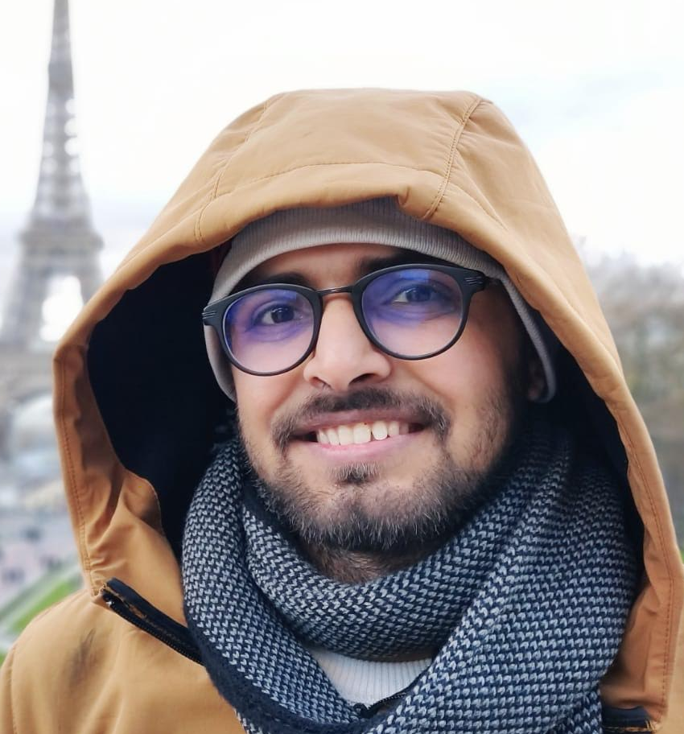
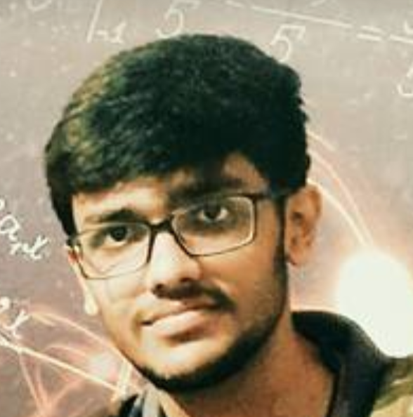
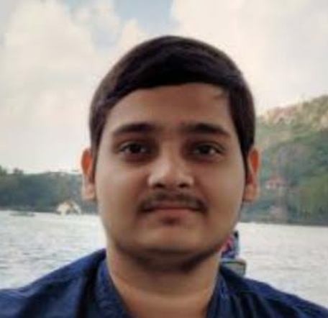
GSoC 2019 Students
Dhiraj Yadav Indian Institute of Technology Mandi
Sharad Shukla Indian Institute of Technology Mandi
Aakash Lahoti Indian Institute of Technology Kanpur
Tanmay Anand Indian Institute of Technology Kanpur

Slide 4
GSoC 2020 Projects cont..
Linux GUI application (can be part of GNOME printer tool) to admin MF devices using IPP System Service: The student's task will be to create an appropriate printer configuration interface for system-config-printer or for the GNOME Control Center.
Common Print Dialog Backends (CPDB) Qt implementation: The Qt Print Support framework should be updated with the CPD support. The goal is to provide the CPD GUI features and d-bus communications with the CPD backend support for printing from Qt5 applications on support platforms.
IPP scan (or virtual MF device) server (Scanner Application): This task is about adding the scan server functionality. If you have a scanner connected locally (and it scans via SANE), share it as an IPP scanner, advertising itself and accepting jobs using the IPP driverless scanning standard.
General Printer Application SDK: Goal is to get a universal Printer Application SDK (Software Development Kit) to not only convert classic drivers but also to create new printer drivers, from scratch, without PPD files.
Make Printer Applications configurable: The student's task is to create libraries, utilities, contribute to the Printer Application framework to get configurability in the Printer Applications. One could perhaps have two students, one for IPP System Service and one for a web interface..

Slide 5
GSoC 2020 Projects cont..
Speed/scaling optimization of cups-browsed: In this project the student should analyse the performance of cups-browsed with many remote printers and optimize it, using things like multi-threading for example.
Extract raster data from PDFs for direct printing: The student's task here is to find out about suitable raster-only PDF types (at least PCLm should be supported, the more file types, the better), make these files get identified, and write a CUPS filter which extracts the raster data and passes it on as CUPS Raster. The resulting code will get added to the cups-filters project.
Check here for more details..
7 Projects
14 Mentors
Highest count till date in OP - GSoC history

Slide 6
GSoC 2020 Mentors & Admins
Till Kamppeter
Michael Sweet
Ira McDonald
Smith Kennedy
Danny Brennan
Zdenek Dohnal
Alexander Pevzner
Thierry Ordissimo
Dongxu Li
Sahil Arora
Deepak Patankar
Rithvik Patibandla
Nilanjana Lodh
Dheeraj Yadav
Welcome New
Mentors !!
Admins: Till Kamppeter Aveek Basu

Slide 7
OP Issues Fixed
117 # Graceful/Consistent handling of zero-page jobs : Jai Luthra
130 # Huge issue with CUPSD : high CPU usage when starting with lot of printers : Jai Luthra
95 # Replace cupsTempFd() with tmpfile() : Jai Luthra
135 # CJK text file printing : Sambhav Dusad
176 # HP Designjet T1100 Impossible to print landscape - always autorotate : Sambhav Dusad
193 # Tray/InputSource setting is ignored : Sambhav Dusad
201 # driverless generates wrong Input Slots for a Xerox B215 : Sambhav Dusad
02 # openprinting-ppds: MemoryError : Sambhav Dusad
194 # SAMSUNG C410W don't work : Priyadarshi Singh
125 # The IPP Everywhere "driver" and system-config-printer : Priyadarshi Singh
125 # NewBrowsePollQueuesShared option? : Vikrant Malik
Thank You Students !!
Special Thanks to Sambhav for fixing highest number of bugs..

Slide 8
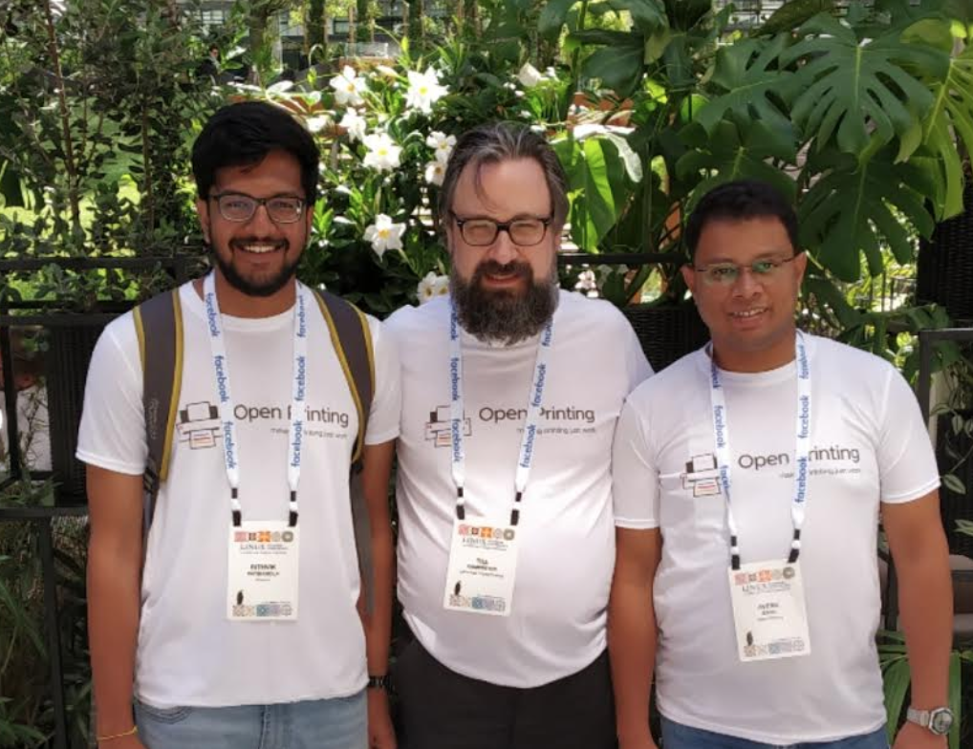
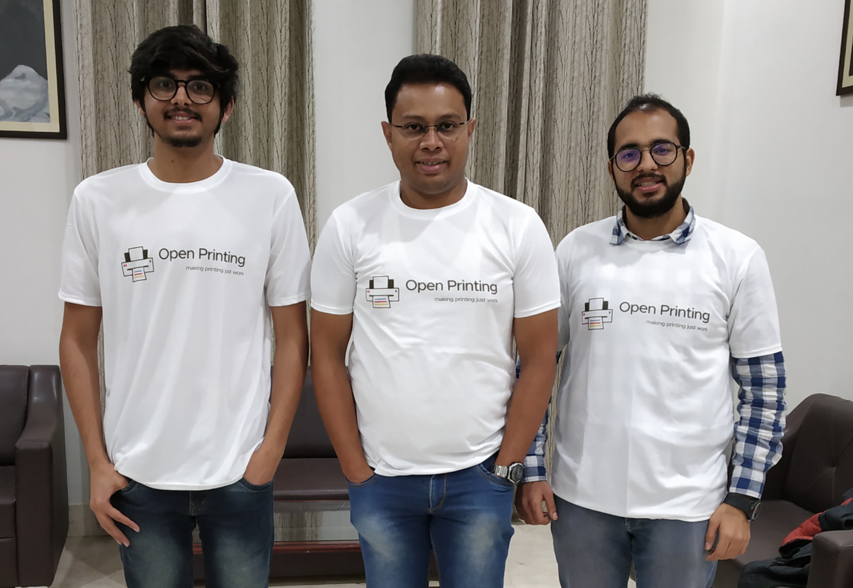
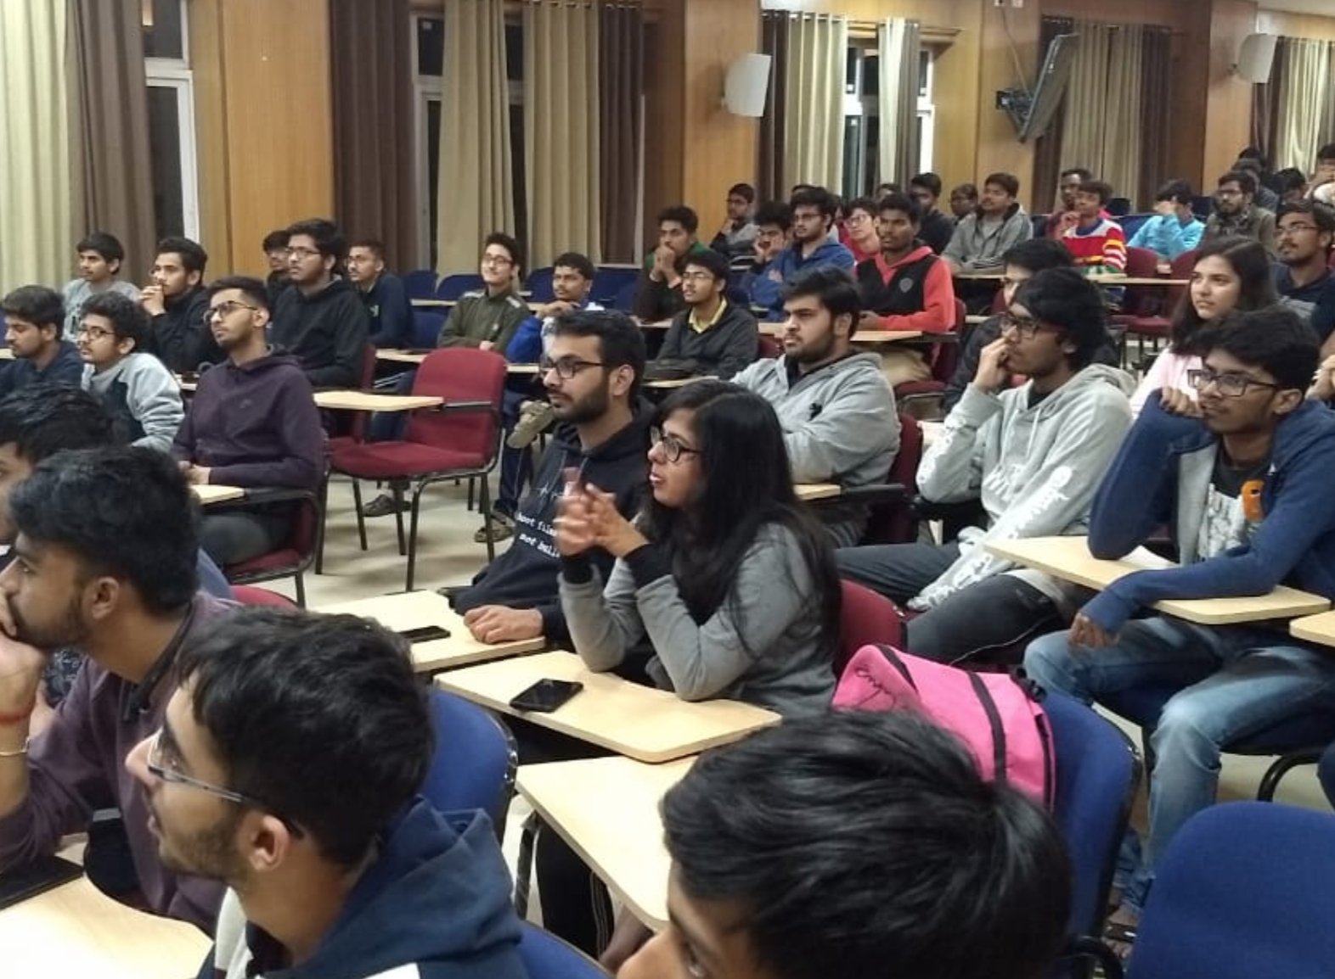
OP Initiatives
Linux Plumber’s Conference 2019 (Lisbon - Portugal): OP participated at Linux Plumber’s 19. We had a 4 hrs Micro Conference session on Printing in Linux. Speakers: Aveek, Till & Rithvik Link: https://linuxplumbersconf.org/event/4/sessions/52/#20190910 Media Coverage: https://lwn.net/Articles/798916/
Linux Foundation Member’s Summit 20: Our submission, “Revitalizing an Open Source Community - Nurturing the new contributors to carry on the baton” was accepted for LFMS 20. Aveek & Till were invited as speakers. Unfortunately due to COVID 19 the event got cancelled.
Rithvik, Till & Aveek at Linux Plumber’s 19
Open Printing Mini Conference: We had a mini Open Printing Conference with the students of Indian Institute of Technology Mandi at their campus on Nov 19 .
Upcoming for 2020:
OP plans to participate in Plumber’s 20 & Linux Foundation Mentorship Program
Dhiraj, Aveek & Sahil with the other students of IIT- Mandi

Slide 9
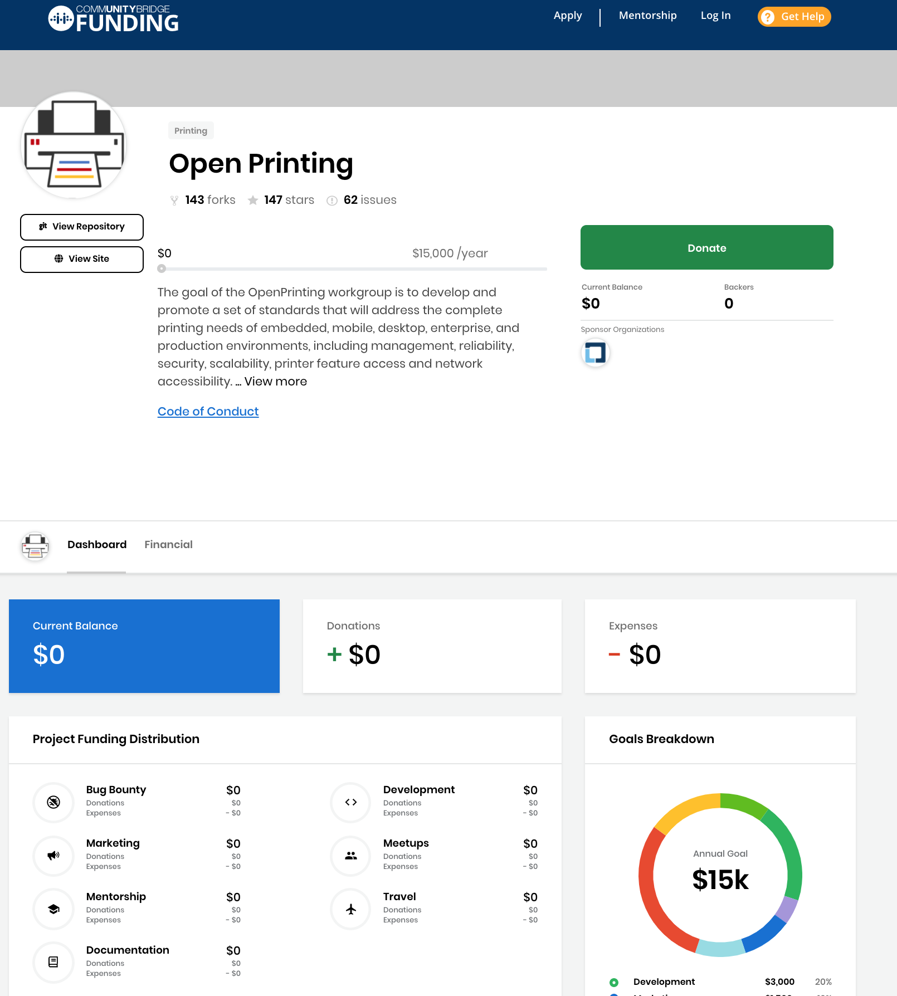
The Linux Foundation - OP Community Bridge
We need your support in growing Open Printing and making it a stronger organization. Help us to help you in a better way..!!
Special Thanks to Kate Stewart & Jeff Licquia from The Linux Foundation for mentoring us..!!
Link to Community Bridge Project: https://funding.communitybridge.org/projects/open-printing

Slide 10
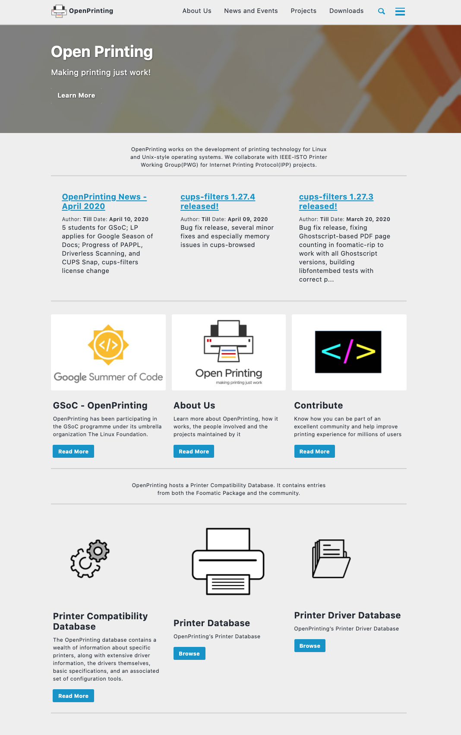
OP Website is Full Functional
Thank You
Dhiraj, Sahil, Nilanjana, Abhishek
and all our students who have worked on developing this new OP website.
Web Page: http://www.openprinting.org/

Slide 11
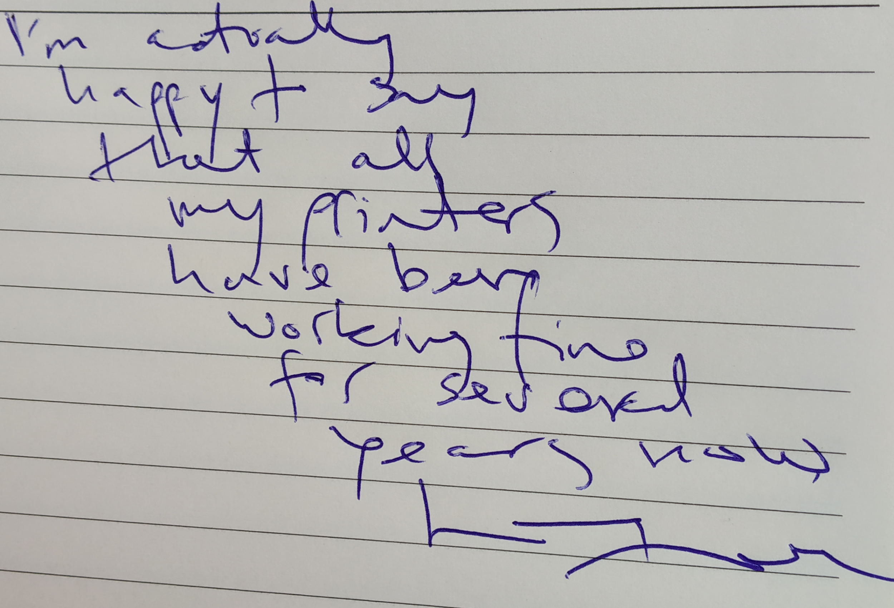
A Note..!!
“I’m actually happy to say that all my printers have been working fine for several years now…” Linus Trovalds

Slide 12
Thank You
Thank You !!
Twitter: Open_Printing Telegram: Join Us Email: basu.aveek@gmail.com, till.kamppeter@gmail.com

