Slide 1

IPP Workgroup Session, Day 1
®
The Printer Working Group
May 3, 2017
Copyright © 2017 The Printer Working Group. All rights reserved. The IPP Everywhere and PWG logos are registered trademarks of the IEEE-ISTO.

Slide 2

PWG IP Policy
®
"This meeting is being held in accordance with the PWG Intellectual Property Policy"
  http://www.pwg.org/chair/membership_docs/pwg-ip-policy.pdf
TL;DR: Anything you say in a PWG meeting or email to a PWG address can be used in a PWG standard
  (but please do read the IP policy above if you haven't done so)
Copyright © 2017 The Printer Working Group. All rights reserved. The IPP Everywhere and PWG logos are registered trademarks of the IEEE-ISTO.

Slide 3
Agenda
®
May 3, 2017
When | What
12:30 - 1:30 | IPP Workgroup Status and Updates
1:30 - 2:30 | IPP System Service
May 4, 2017
When | What
12:30 - 1:45 | White Papers
1:45 - 2:15 | PWG 3D Print Job Ticket
2:15 - 2:30 | Next Steps
Copyright © 2017 The Printer Working Group. All rights reserved. The IPP Everywhere and PWG logos are registered trademarks of the IEEE-ISTO.

Slide 4
Charter
®
Current charter:
  http://ftp.pwg.org/pub/pwg/ipp/charter/ch-ipp-charter-20151225.pdf
The Internet Printing Protocol (IPP) workgroup is chartered with the maintenance of IPP, the IETF IPP registry, and support for new clients, network architectures (Cloud, SDN), service bindings for MFDs and Imaging Systems, and emerging technologies such as 3D Printing
In addition, we maintain the IETF Finisher MIB, Job MIB, and Printer MIB registries, and handle synchronization with changes in IPP
Minor charter update in progress (talk about this later)
Copyright © 2017 The Printer Working Group. All rights reserved. The IPP Everywhere and PWG logos are registered trademarks of the IEEE-ISTO.

Slide 5
Officers
®
IPP WG Co-Chairs:
  Paul Tykodi (TCS)
  Ira McDonald (High North)
IPP WG Secretary:
  Michael Sweet (Apple)
IPP WG Document Editors:
  Ira McDonald (High North) – IPP System Service (SYSTEM)
  Michael Sweet (Apple) – IPP System Service (SYSTEM), PWG 3D Print Job Ticket and Associated Capabilities v1.0 (PJT3D)
  Smith Kennedy (HP Inc.) – Various white papers
Copyright © 2017 The Printer Working Group. All rights reserved. The IPP Everywhere and PWG logos are registered trademarks of the IEEE-ISTO.

Slide 6
Status (1/2)
®
PWG Specifications in development:
  PWG 3D Print Job Ticket and Associated Capabilities v1.0 (PJT3D)
  - Stable Draft
  IPP System Service (SYSTEM) - Interim Draft
Recent Candidate Standards:
  PWG 5100.1-2017: IPP Finishings 2.1 (FIN)
  PWG 5100.20-2016: IPP Everywhere Printer Self-Certification Manual v1.0 (SELFCERT)
  PWG 5100.21-2017: IPP 3D Printing Extensions v1.0 (3D)
Recent IETF RFCs:
  RFC 8010: Internet Printing Protocol/1.1: Encoding and Transport
  RFC 8011: Internet Printing Protocol/1.1: Model and Semantics
Copyright © 2017 The Printer Working Group. All rights reserved. The IPP Everywhere and PWG logos are registered trademarks of the IEEE-ISTO.

Slide 7
Status (2/2)
®
Up-to-date pending IANA registrations online:
  http://www.pwg.org/ipp/ipp-registrations.xml
  Continue to maintain this in parallel for new specifications
  Github repository: https://github.com/istopwg/ippregistry
IPP Everywhere Printer Self-Certifications:
  https://www.pwg.org/printers
  47 printers currently listed
  1.0 self-certification tools update released in October 2016
IPP Sample Code:
  Github repository:
    https://github.com/istopwg/ippsample
  Fork of CUPS code includes ippfind, ippproxy, ippserver, ipptool, ipptransform, and ipptransform3d
Copyright © 2017 The Printer Working Group. All rights reserved. The IPP Everywhere and PWG logos are registered trademarks of the IEEE-ISTO.

Slide 8
IETF IPP/1.1 Updates
®
RFCs 8010 and 8011 have been published which replace (obsolete) RFCs 2910, 2911, 3381 (deprecated job progress attributes), and 3382 (collection attribute syntax)
Published RFCs:
  http://tools.ietf.org/html/rfc8010
  http://tools.ietf.org/html/rfc8011
  RFCs will eventually be advanced to IETF Internet Standard through status change (IESG process described in RFCs 2026 and 6410)
Proposed schedule:
  Request IESG change of status in July 2017 (six months after the publication of RFCs 8010 and 8011)
Copyright © 2017 The Printer Working Group. All rights reserved. The IPP Everywhere and PWG logos are registered trademarks of the IEEE-ISTO.

Slide 9
IPP Everywhere Self-Certification
®
Resources:
  http://www.pwg.org/ipp/everywhere.html (for tools/info)
  https://www.pwg.org/ippeveselfcert (submission form)
  http://www.pwg.org/printers (printer list)
  https://github.com/istopwg/ippeveselfcert (Github repo)
Released v1.0 Update 1 of self-certification tools on October 28th, 2016
Planning future 1.1 errata update for manual and tools in 2017:
  More tests (Cancel-My-Jobs, Close-Job, Identify-Printer)
  Other necessary changes that are not simple bug fixes in the tools/submission portal
Proposed Schedule:
  1.1 errata update: Q3 2017
Copyright © 2017 The Printer Working Group. All rights reserved. The IPP Everywhere and PWG logos are registered trademarks of the IEEE-ISTO.

Slide 10
IPP WG Charter Update
®
Current (interim) draft at:
  http://ftp.pwg.org/pub/pwg/ipp/wd/wd-ipp-charter-20170314-rev.pdf
Changes:
  Move IPP Everywhere Multifunction to potential projects list
  Move maintenance tasks to new "ongoing" section
  Add ongoing PWG Semantic Model schema maintenance via IANA IPP Registry tools
Proposed schedule:
  PWG Steering Committee approval in Q3 2017
Copyright © 2017 The Printer Working Group. All rights reserved. The IPP Everywhere and PWG logos are registered trademarks of the IEEE-ISTO.

Slide 11
IPP System Service (SYSTEM)
®
Current interim draft at:
  http://ftp.pwg.org/pub/pwg/ipp/wd/wd-ippsystem10-20170314-rev.pdf
Combines and implements a concrete IPP binding of the following abstract Semantic Model 2.0 services and objects:
  PWG 5108.06: System Object and System Control Service
  PWG 5108.03: Network Resource Service
  PWG 5109.1: Cloud Imaging Requirements and Model
Proposed Schedule:
  Prototype draft in Q3 2017
Copyright © 2017 The Printer Working Group. All rights reserved. The IPP Everywhere and PWG logos are registered trademarks of the IEEE-ISTO.

Slide 12
IPP Workgroup Session, Day 2
®
The Printer Working Group
May 4, 2017
Copyright © 2017 The Printer Working Group. All rights reserved. The IPP Everywhere and PWG logos are registered trademarks of the IEEE-ISTO.

Slide 13
PWG IP Policy
®
"This meeting is being held in accordance with the PWG Intellectual Property Policy"
  http://www.pwg.org/chair/membership_docs/pwg-ip-policy.pdf
TL;DR: Anything you say in a PWG meeting or email to a PWG address can be used in a PWG standard
  (but please do read the IP policy above if you haven't done so)
Copyright © 2017 The Printer Working Group. All rights reserved. The IPP Everywhere and PWG logos are registered trademarks of the IEEE-ISTO.

Slide 14
Agenda
®
May 3, 2017
When | What
12:30 - 1:30 | IPP Workgroup Status and Updates
1:30 - 2:30 | IPP System Service
May 4, 2017
When | What
12:30 - 1:45 | White Papers
1:45 - 2:15 | PWG 3D Print Job Ticket
2:15 - 2:30 | Next Steps
Copyright © 2017 The Printer Working Group. All rights reserved. The IPP Everywhere and PWG logos are registered trademarks of the IEEE-ISTO.

Slide 15
"Get-User-Printer-Attributes" Proposal
®
White Paper:
  http://ftp.pwg.org/pub/pwg/ipp/whitepaper/tb-userop-20170404.pdf
Get-User-Printer-Attributes Operation
  Provides a Get-Printer-Attributes response filtered by the most authenticated user
  Useful for things like limiting which users can print in color, use a particular letterhead, etc.
  Clients that support the operation will only show available print options to the user instead of reporting an error (or having the options silently overridden by the Printer) when the user submits the job
  Needed because Get-Printer-Attributes is not defined as an authenticated operation (so no clients support it), nor does it include the "most authenticated user identity" as a filter criteria (which isn't something we can expose using "printer-get-attributes-supported")
Copyright © 2017 The Printer Working Group. All rights reserved. The IPP Everywhere and PWG logos are registered trademarks of the IEEE-ISTO.

Slide 16
"IPP Presets" Proposal
®
White Paper:
  http://ftp.pwg.org/pub/pwg/ipp/whitepaper/tb-ipp-preset-20170418.pdf
"presets-col" and "presets-col-set" Printer Description attributes
Provides a way for Clients to know that selection of one Job Template attribute value should also select others, e.g., selecting 4x6 media should also trigger "print-quality" getting set to 'high'.
Copyright © 2017 The Printer Working Group. All rights reserved. The IPP Everywhere and PWG logos are registered trademarks of the IEEE-ISTO.

Slide 17
PWG 3D Print Job Ticket
®
Current stable draft:
  http://ftp.pwg.org/pub/pwg/ipp/wd/wd-smpjt3d10-20170420-rev.pdf
Current schema:
  https://istopwg.github.io/ippregistry/smpjt3d10-current
Proposed schedule:
  WG Last Call Q2 2017
  PWG Last Call and Formal Vote Q3 2017
Copyright © 2017 The Printer Working Group. All rights reserved. The IPP Everywhere and PWG logos are registered trademarks of the IEEE-ISTO.

Slide 18
Next Steps
®
The Printer Working Group
Copyright © 2017 The Printer Working Group. All rights reserved. The IPP Everywhere and PWG logos are registered trademarks of the IEEE-ISTO.

Slide 19
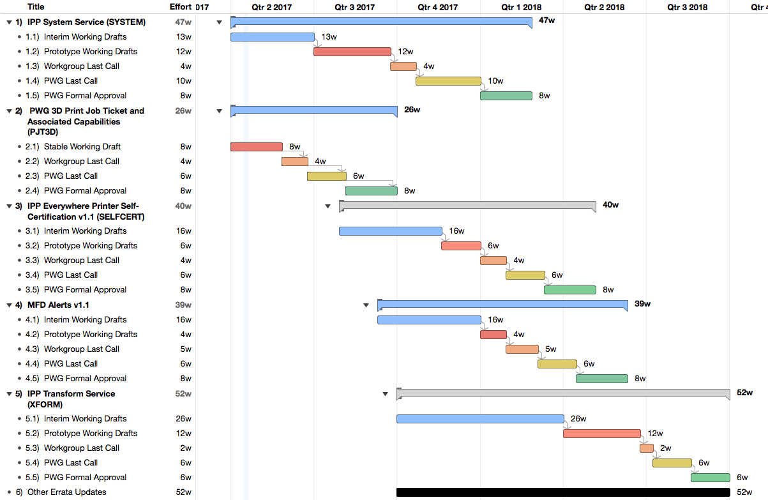
Next Steps
®
Copyright © 2017 The Printer Working Group. All rights reserved. The IPP Everywhere and PWG logos are registered trademarks of the IEEE-ISTO.

Slide 20
Next Steps
®
Advance IPP/1.1 to IETF Internet Standard
  Request change of status in July 2017
PWG 3D Print Job Ticket and Associated Capabilities v1.0 (Mike)
  Start WG Last Call
IPP System Service (Ira/Mike)
  Prototype working draft in Q3 2017
IPP Everywhere Printer Self-Certification Manual v1.1 (Mike/Smith)
  Interim working draft in Q3 2017
MFD Alerts v1.1 (Ira/Mike - Errata Update)
  Initial working draft in Q3 2017
IPP Transform Service v1.0 (Ira/Paul)
  Initial working draft in Q4 2017
Copyright © 2017 The Printer Working Group. All rights reserved. The IPP Everywhere and PWG logos are registered trademarks of the IEEE-ISTO.

Slide 21
More Information
®
We welcome participation from all interested parties
IPP Working Group web page
  http://www.pwg.org/ipp/index.html
Subscribe to the IPP mailing list
  https://www.pwg.org/mailman/listinfo/ipp
IPP WG holds weekly phone conferences announced on the IPP mailing list
  Next conference calls scheduled for Thursday, May 18, 2017 and June 1, 2017 at 3pm ET
Copyright © 2017 The Printer Working Group. All rights reserved. The IPP Everywhere and PWG logos are registered trademarks of the IEEE-ISTO.

