Slide 1
Mopria Alliance
Introduction
October 22, 2013

Slide 2
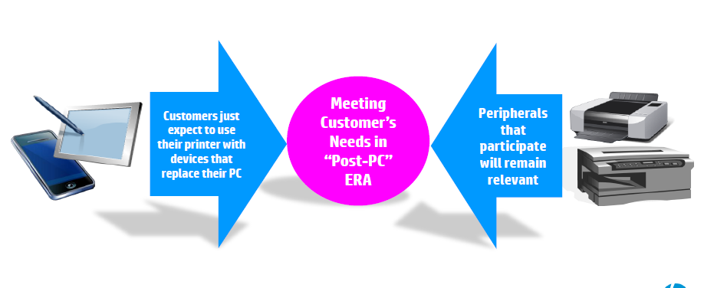
Printing evolution in a world dominated by mobile devices

Slide 3





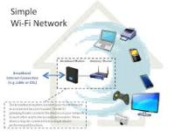

Standards
Standards are the building blocks
Open Standards Foster Rapid Innovation
Raster

Slide 4



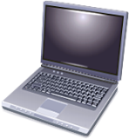
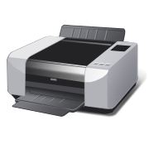

How: The Initial Standards
Wired
Local Network
Wireless
WiFi Direct
Mobile App
Mobile Device
Printer
Open API to deploy print functionality and convert files to accepted formats
Print Subsystem
to convert files to accepted formats & discover printers (Bonjour)
User Experience guidelines
WiFi Direct Services – Print:
specific application of WiFi Direct to pass data between mobile and print device
NFC touch-to-print option:
NFC implementation requirements
File types selected for print job rendering:
    PWG Raster
    PCLm
    JPEG
    PDF (future)

Slide 5





Certification Process
Final Step
WiFi Alliance Certified
PWG Certified
NFC Certified
=
Certification
Mopria Suite
File Formats
PWG Raster – Encode raster found line printer
PCLm – Objected XX (PDF subset)
JPEG – Photo printer
To be Supported → PDF – Document exchange

